Slide 1
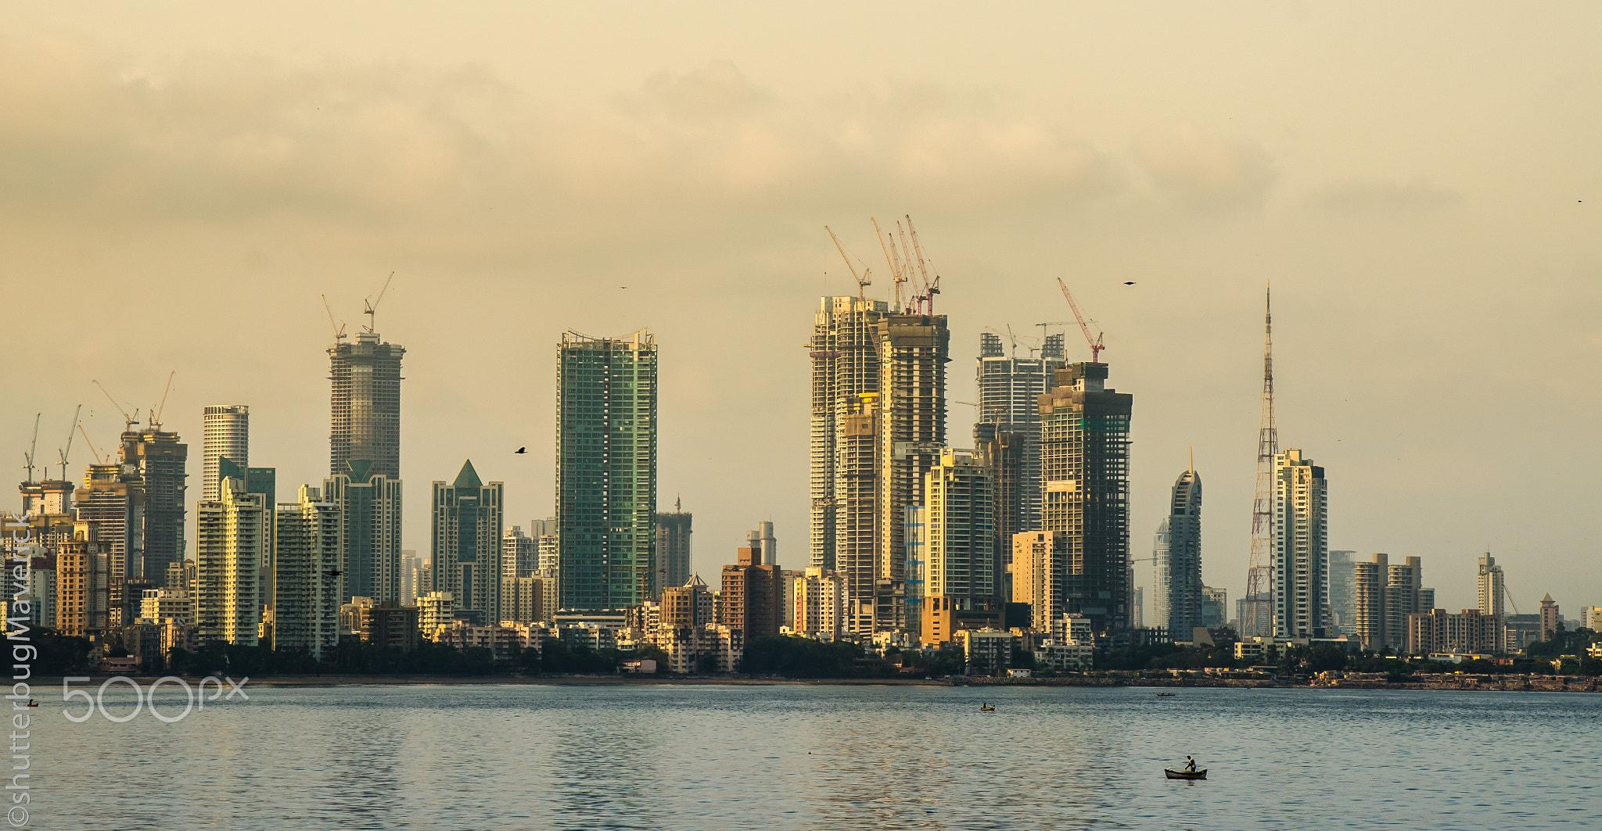
Coursera Capstone
IBM Applied Data Science
Battle of Cafes -Mumbai
by
Shashank Wankhede

Slide 2
Introduction
Coffee being a most consumed beverage in the world. This project is for those who love coffe much and always wanted to explore coffee shops around cities.Basically it will help tourists/coffee to explore nearby coffee shops and also people who want to open a new coffee shop and looking for a less or more crowded place in Mumbai. With the help of data science we can group places or neighborhoods according to number of cafes available also with advanced business analysis we can advice any one who wants to open a new coffee shop

Slide 3
Business Problem:
The objective of this capstone project is to guide tourists so that they can stay nearby most of coffee shops or explore most of the coffee shops and also to analyse a proper location to open new coffee shop with less competition around using the power of data and machine learning

Slide 4
Data Description
To solve the problem, we will need the following data:
List of neighbourhoods in Mumbai .This defines the scope of this project which is confined to the city of Mumbai
Latitude and longitude coordinates of those neighbourhoods.This is required in order to plot the map and also to get the venue data.
Venue data, particularly data related to venues.

Slide 5
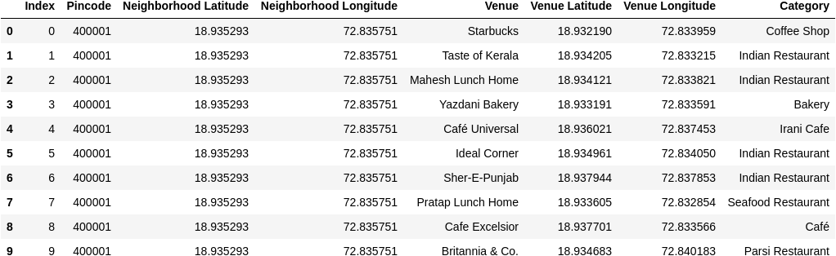
Dataset

Slide 6
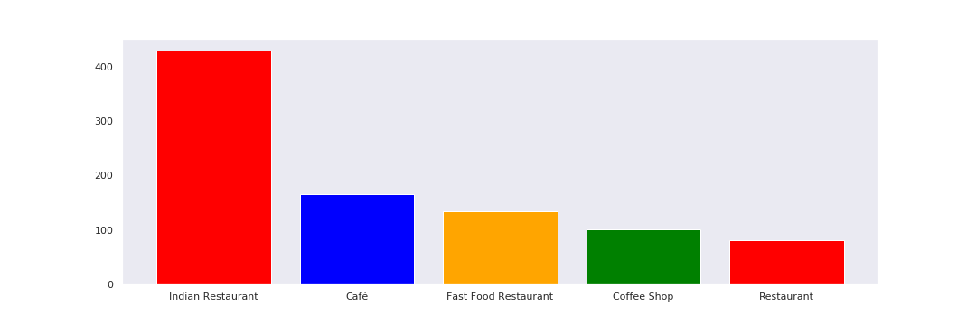
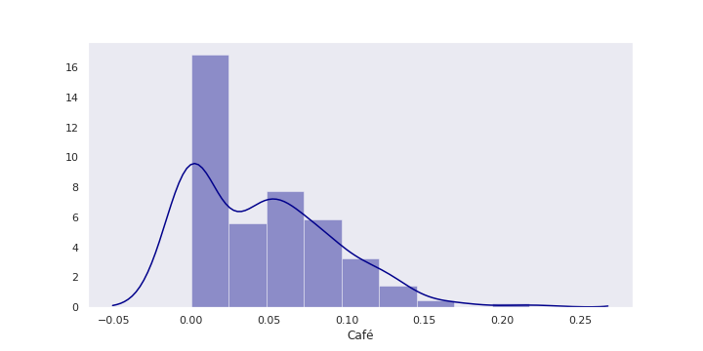
Exploratory Data Analysis:
Count of Categories
Frequency Distribution of Cafes

Slide 7
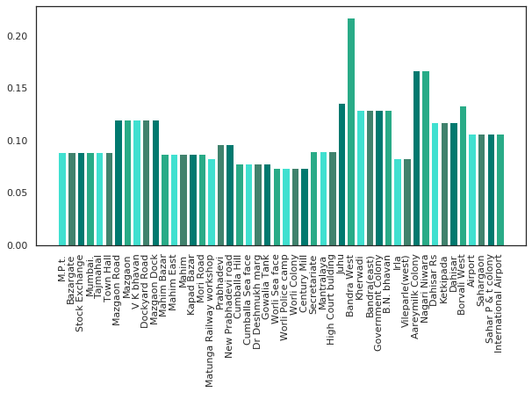
Neighborhoods with frequency

Slide 8
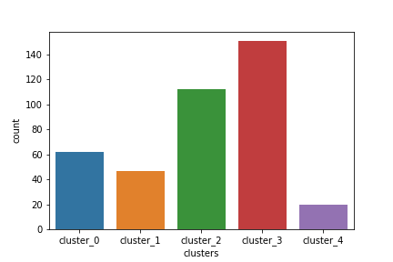
Cluster Count
from the above figure we can say that cluster 3 has more cafes
Neighborhood belonging to cluster 3 has frequency 0.08

Slide 9
Conclusion:
Neighborhood Juhu is repeated as because there are more cafes and also the cafe called Grub shop is also repeated as it is in radius of more than one neighborhood that is why location is same . Which means that if you are in Juhu you may find many cafes around you and if you are in Grub shop you are near to these Neighborhoods
cluster 1 has 0.1 we means that in cluster 1 no of Neighborhood are less but in that small area there are more cafes its concentrated in small area on the other hand Neighborhoods in cluster 3 are widely spread over the region or mumbai
so we can conclude that if you want to explore more cafes in less time you should choose neighborhoods belonging to cluster 2 and 3
also if you want to open a new cafe consider cluster 4 and cluster 0 neighborhoods where compitation seems less

Slide 10

Project by shashank wankhede

